Slide 1

Student Hostel Management System
Course Code: DSA 201
Name: Md. Riyad Ahmed Hridoy

Slide 2

Introduction to Student Hostel Management System
Core Entities
System Purpose and Scope
The system comprises 11 core entities including Hostel, Floor, Room, Bed, Student, Complain, Payment, Allocation, Staff, and Maintenance_Request. Each entity has specific attributes such as hostel_id, student_id, and payment_id as primary keys, ensuring structured data organization.
The Student Hostel Management System is a database-driven tool designed for efficient storage and management of student information, hostel details, staff data, payments, room allocations, and maintenance requests. It enables dynamic management of all hostel functions through a user-friendly database system.

Slide 3

Entity Relationships and Cardinality
Relation | Connected Entity | Cardinality | Meaning
Has | Hostel - Floor | 1:N (Mandatory) | One hostel must have one or more floors, and each floor belongs to one hostel.
Contains | Floor - Room | 1:N (Mandatory) | One floor must contain one or more rooms, and each room belongs to one floor.
Has | Room - Bed | 1:N (Mandatory) | One room can have one or many beds and every bed belongs to one room.
Makes | Student - Payments | 1:N (Optional) | One student can payment zero, one or many and each payment must refer to one student.
Request | Room - Maintenance_Request | 1:N (Optional) | one room may request zero or many maintenance requests and each request must contain a room.
Handles | Staff - Maintenance_Request | M:N (Optional) | One staff member may involve in zero or many maintenances and each maintenance may contain one or many staff.
Files | Student - Complain | 1:N (Optional) | One student may file zero ,one or many complaints and every complaint belongs to one student.
Related_To | Room - Complain | 1:N (Optional) | One room can have zero or more complaints, and each complaint must refer a room.
Assigned | Student - Allocation | 1:N (Optional) | One student may have zero or many allocations over time and each allocation must belong to one student.
Allocated_to | Bed - Allocation | 1:N (Optional) | One bed can participate in many allocations, and every allocation must refer to a bed.
Relationship Details Table

Slide 4
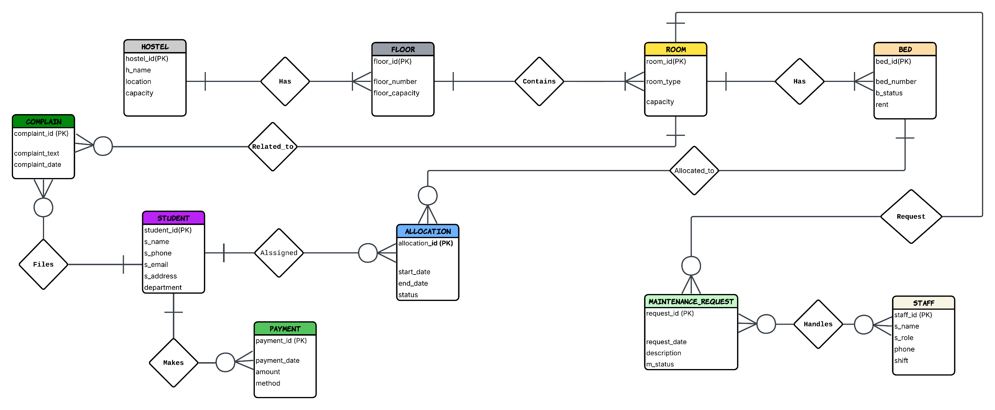
Entity Relationship Diagram (ERD)

Slide 5
Relational Schema Design
1) HOSTEL (hostel_id(PK), h_name, capacity, location)
2) FLOOR (floor_id(PK), hostel_id(FK), floor_number, floor_capacity)
3) ROOM (room_id(PK), floor_id(FK), room_type, room_capacity)
4) BED (bed_id(PK), room_id(FK), bed_number, bed_status, rent)
5) STUDENT (student_id(PK),s_name, s_email, s_phone, s_address, department)
6) COMPLAIN (complaint_id(PK), student_id(FK), room_id(FK), complaint_text, complaint_date)
7) PAYMENT (payment_id(PK), student_id(FK), payment_date, amount, method)
8) ALLOCATION (allocation_id(PK), student_id(FK), bed_id(FK), start_date, end_date, status)
9) STAFF (staff_id(PK), staff_name, staff_role, phone, shift)
10) MAINTENANCE_REQUEST (request_id(PK), room_id(FK), request_date, description, m_status)
11) STAFF_MAINTENANCE (staff_id(FK), request_id(FK))

Slide 6
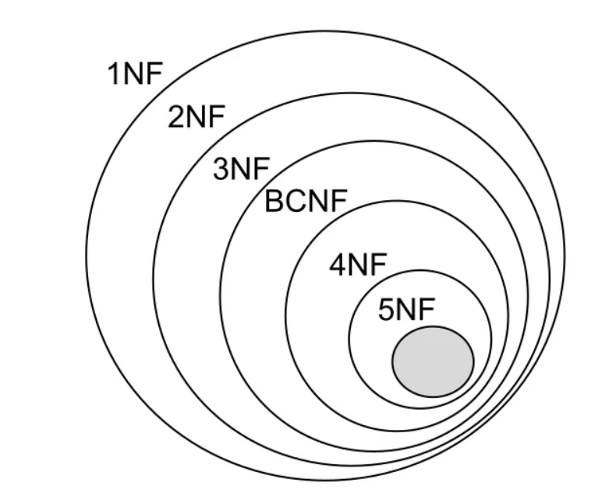
Database Normalization Process
Normalization to 4NF
The database is normalized up to 4NF to minimize redundancy and improve data integrity. 1NF ensures atomic values, 2NF eliminates partial dependencies, 3NF removes transitive dependencies, and 4NF handles multi-valued dependencies using separate tables like STAFF_MAINTENANCE.

Slide 7
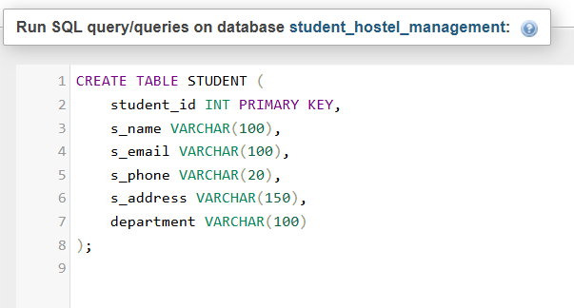
Database Implementation with SQL
DDL and DML Commands
The database "student_hostel_management" is created using CREATE DATABASE. DDL commands define table structures (e.g., CREATE TABLE for HOSTEL, STUDENT, PAYMENT), while DML commands populate tables with data. This ensures a robust and scalable database foundation.

Slide 8
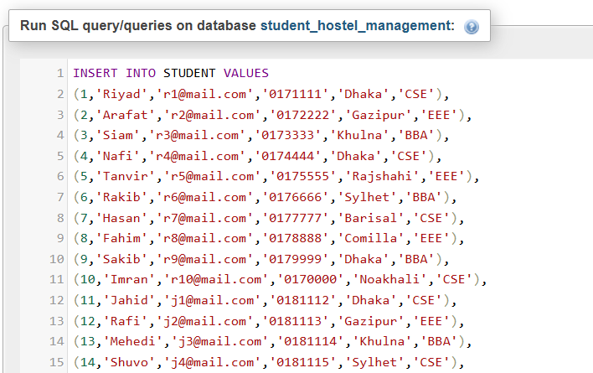
Database Implementation with SQL
Inserting data into STUDENT table

Slide 9
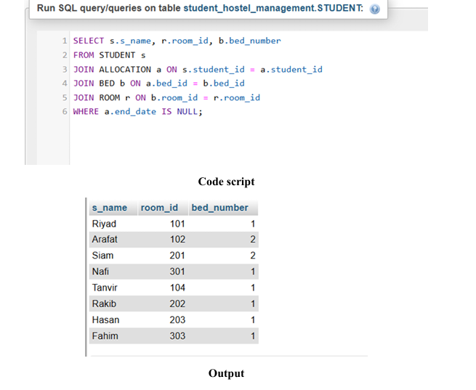
Sample SQL Queries and Outputs
Show students’ name with their room and bed?

Slide 10
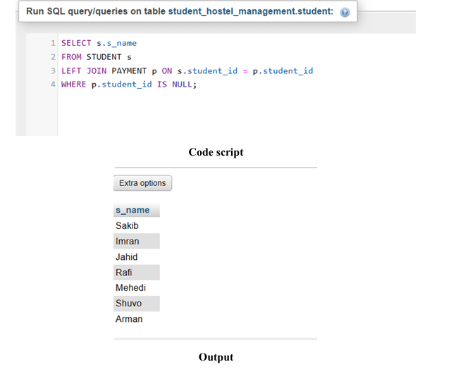
Sample SQL Queries and Outputs
Find the students who haven’t made any payments?

Slide 11
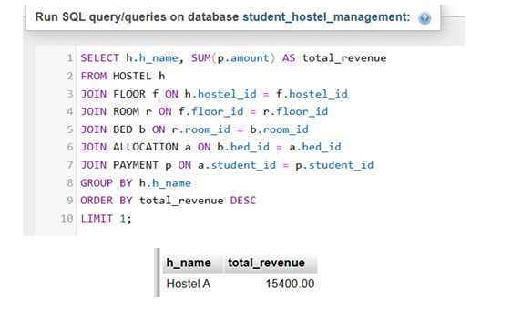
Sample SQL Queries and Outputs
Find the hostel with highest revenue?

Slide 12
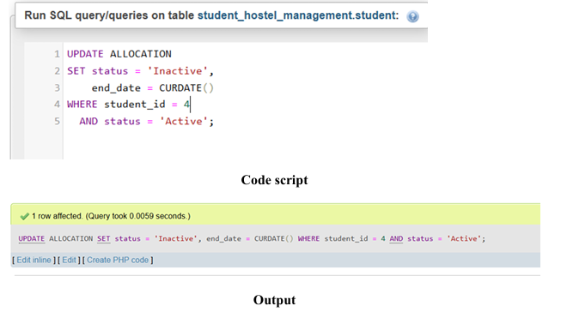
Sample SQL Queries and Outputs
One student has done his hostel day student_id=4. Update the database allocation as inactive and set the end_date to today’s date.

Slide 13
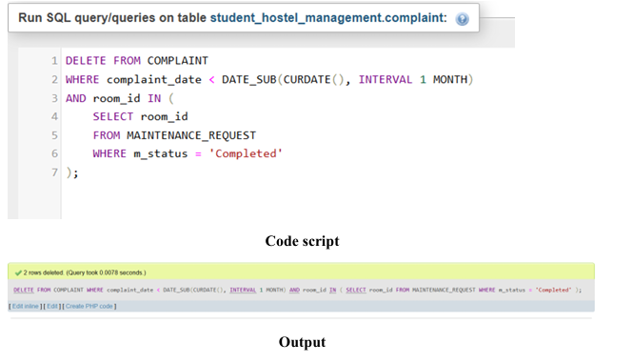
Sample SQL Queries and Outputs
Delete all complaint history from the database that were resolved and are older than 1 month.

Slide 14
System Actors and Functions
Actors and Value-Adding Functions
Actors include Student, Hostel Admin, Staff Team, and Finance Department. Functions like registration, allocation, payment, complaint, and maintenance add value by ensuring efficient, dynamic hostel management with minimal redundancy and high data integrity.

Slide 15
Key Business Processes
01
02
Student Registration and Bed Allocation
Payment and Complaint Management
The admin registers students and stores personal information. After verification, students become eligible for hostel. Bed allocation assigns a bed to a student based on availability, with data stored in the ALLOCATION entity.
Students pay rent via various methods, with data stored in PAYMENT. Complaints are filed for service issues, linked to student and room. Maintenance requests are processed for repairs, supporting all system actors.

Slide 16
THANK YOU

